Slide 1




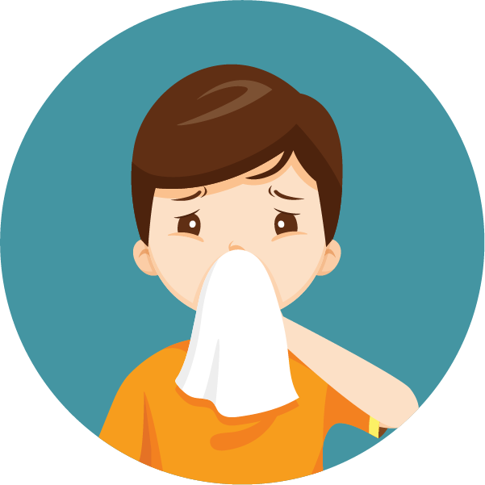
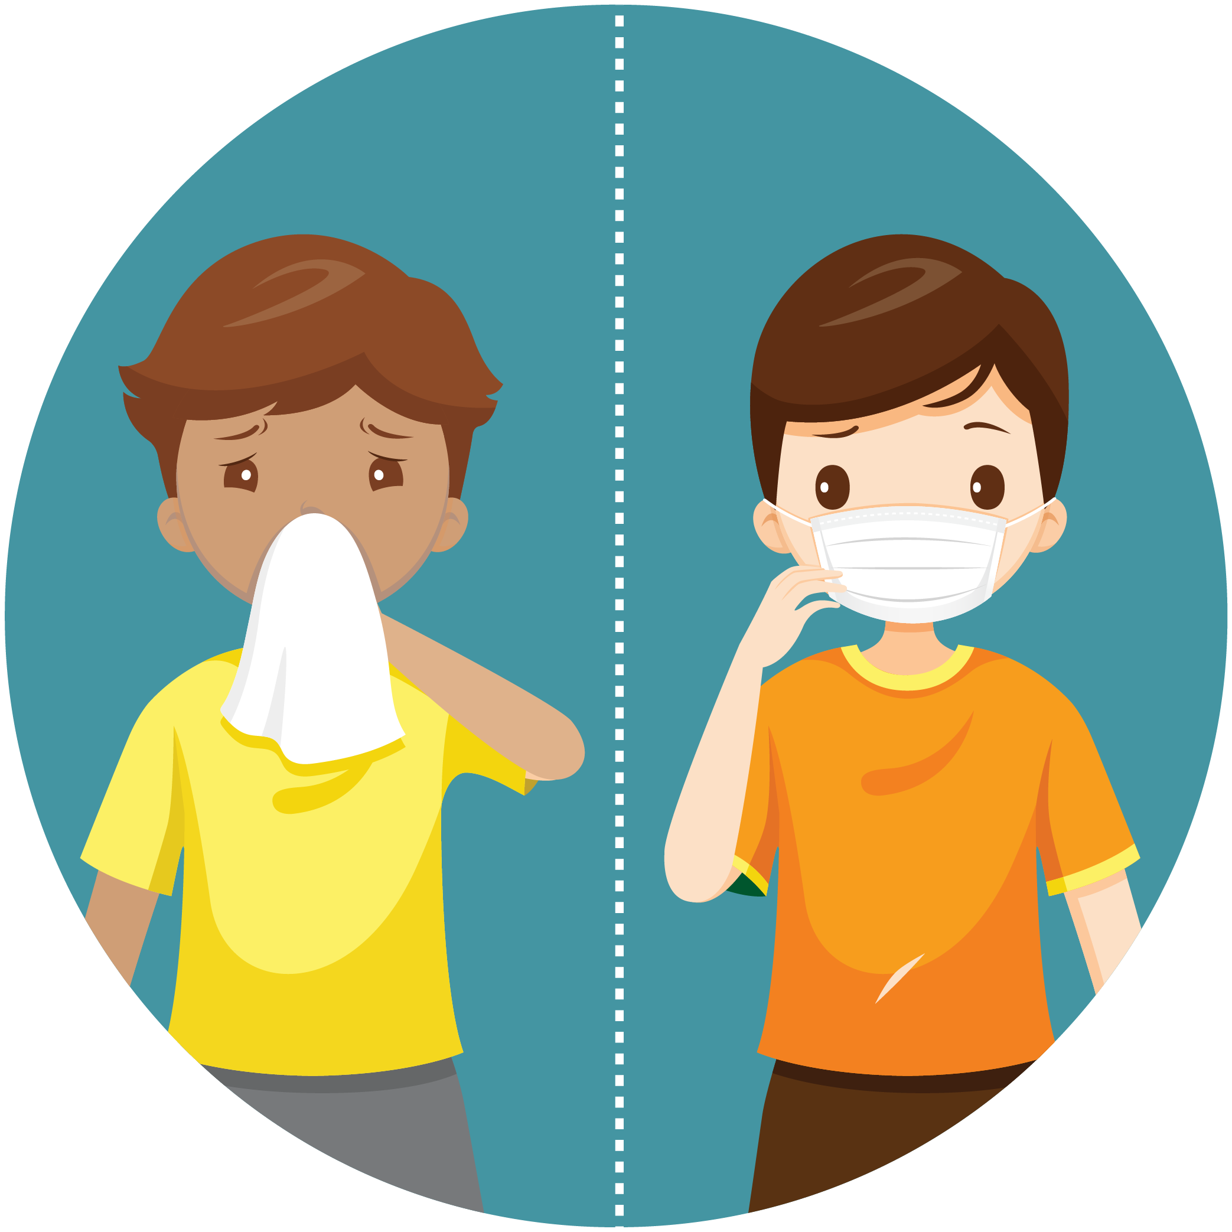


Coronavirus Health and Safety Tips
Wash your hands often
Use hand sanitizer
Wear a mask
Don’t touch your face
Cover your sneezes and coughs
Avoid close contact
Use your own supplies
Clean your electronics

Slide 2

Remember to wash your hands

Slide 3
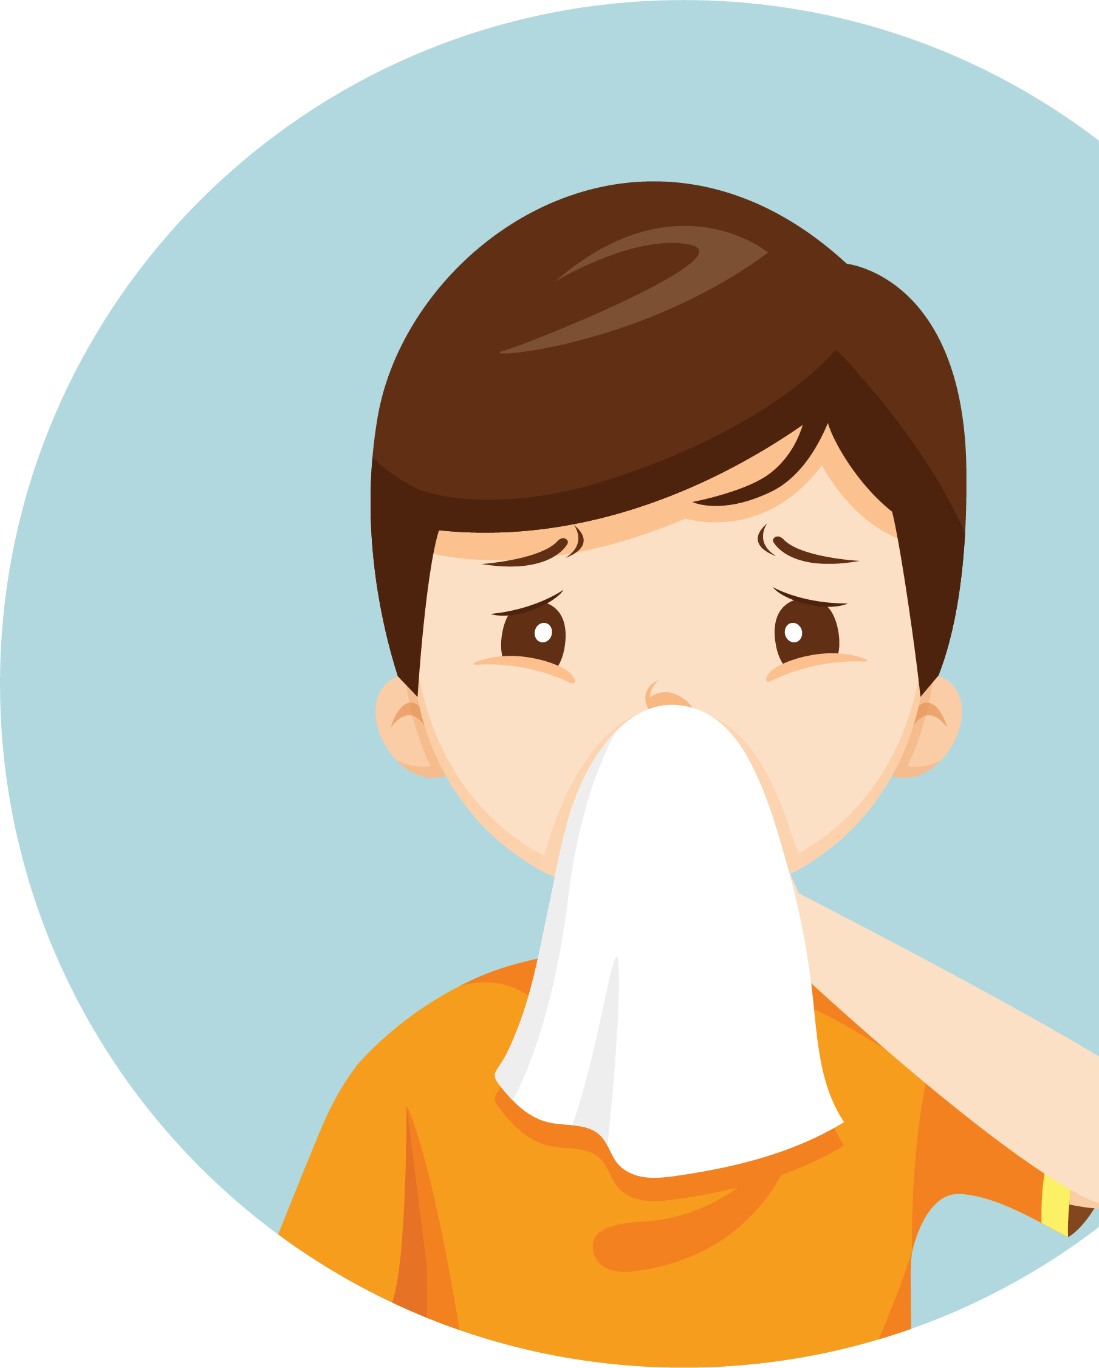
Please cover your cough and sneezes

Slide 4

Please wear a mask

Slide 5

Please wait here

Slide 6
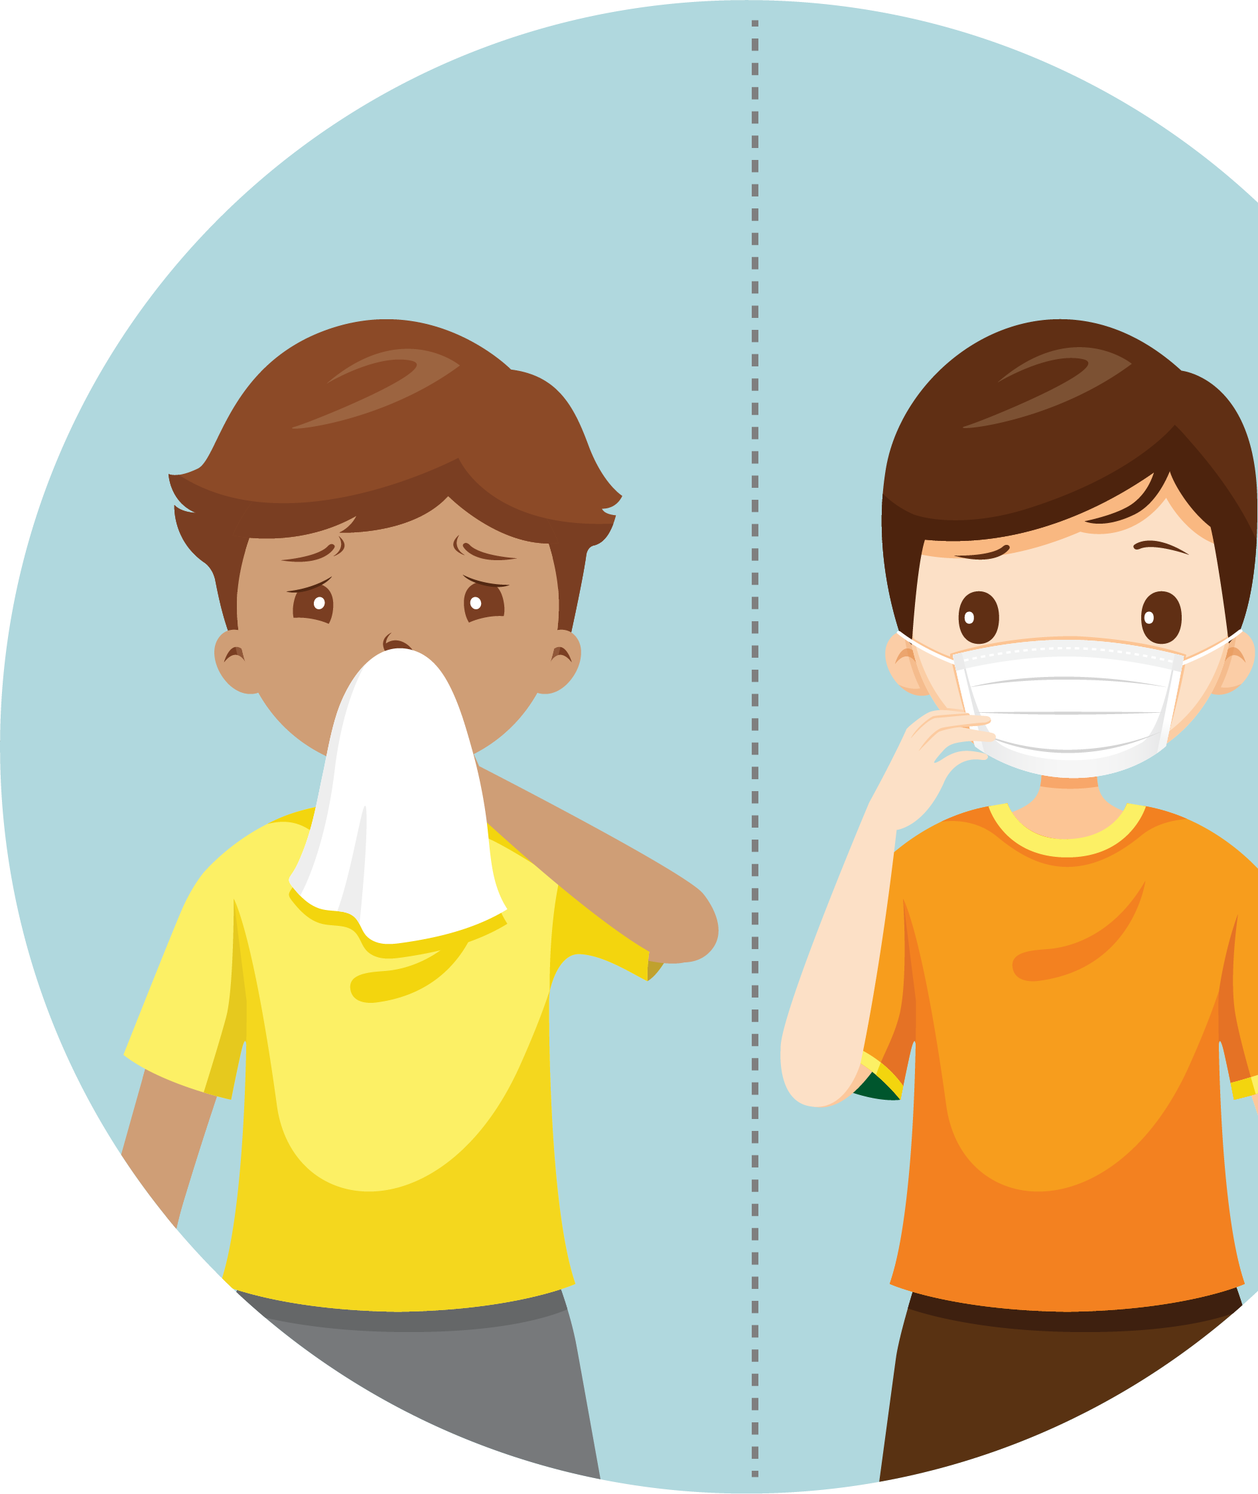
Please practice social distancing

Slide 7

Wipe down between use

Slide 8
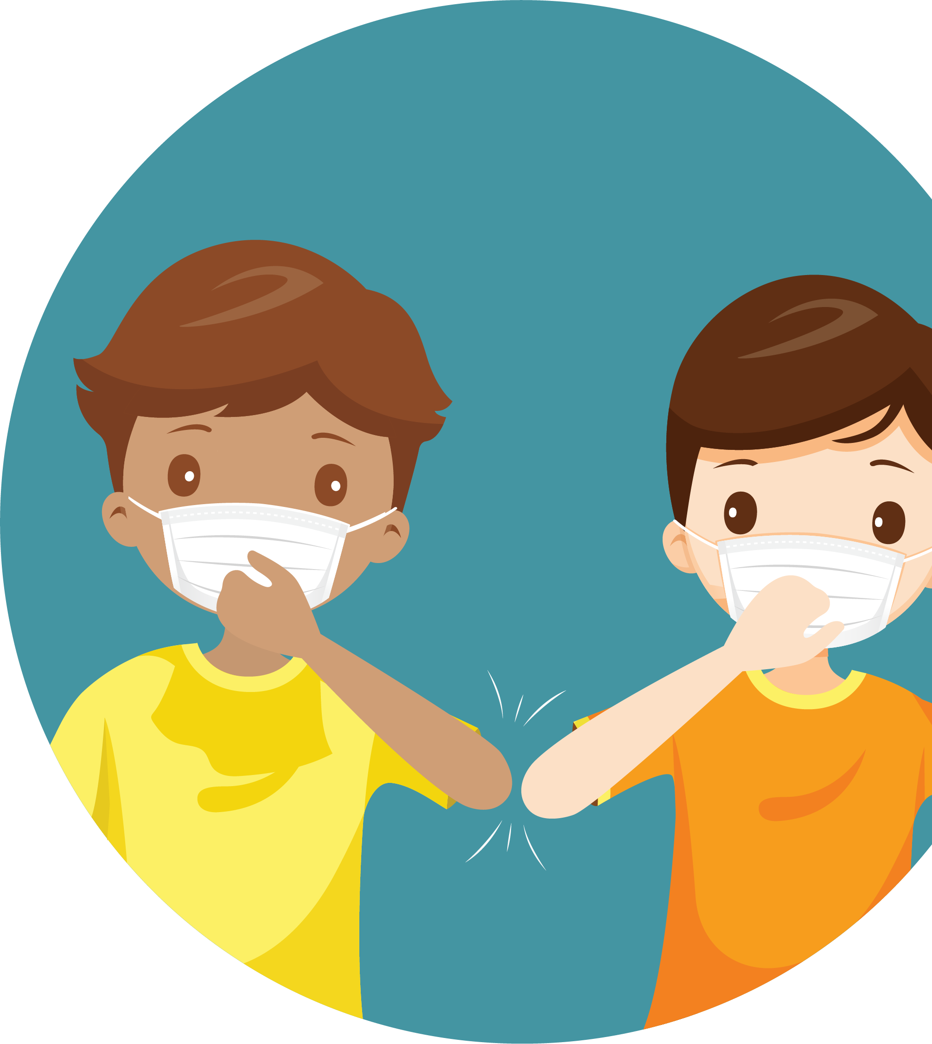
Avoid
shaking
hands,
high fives,
and hugs

